Slide 2
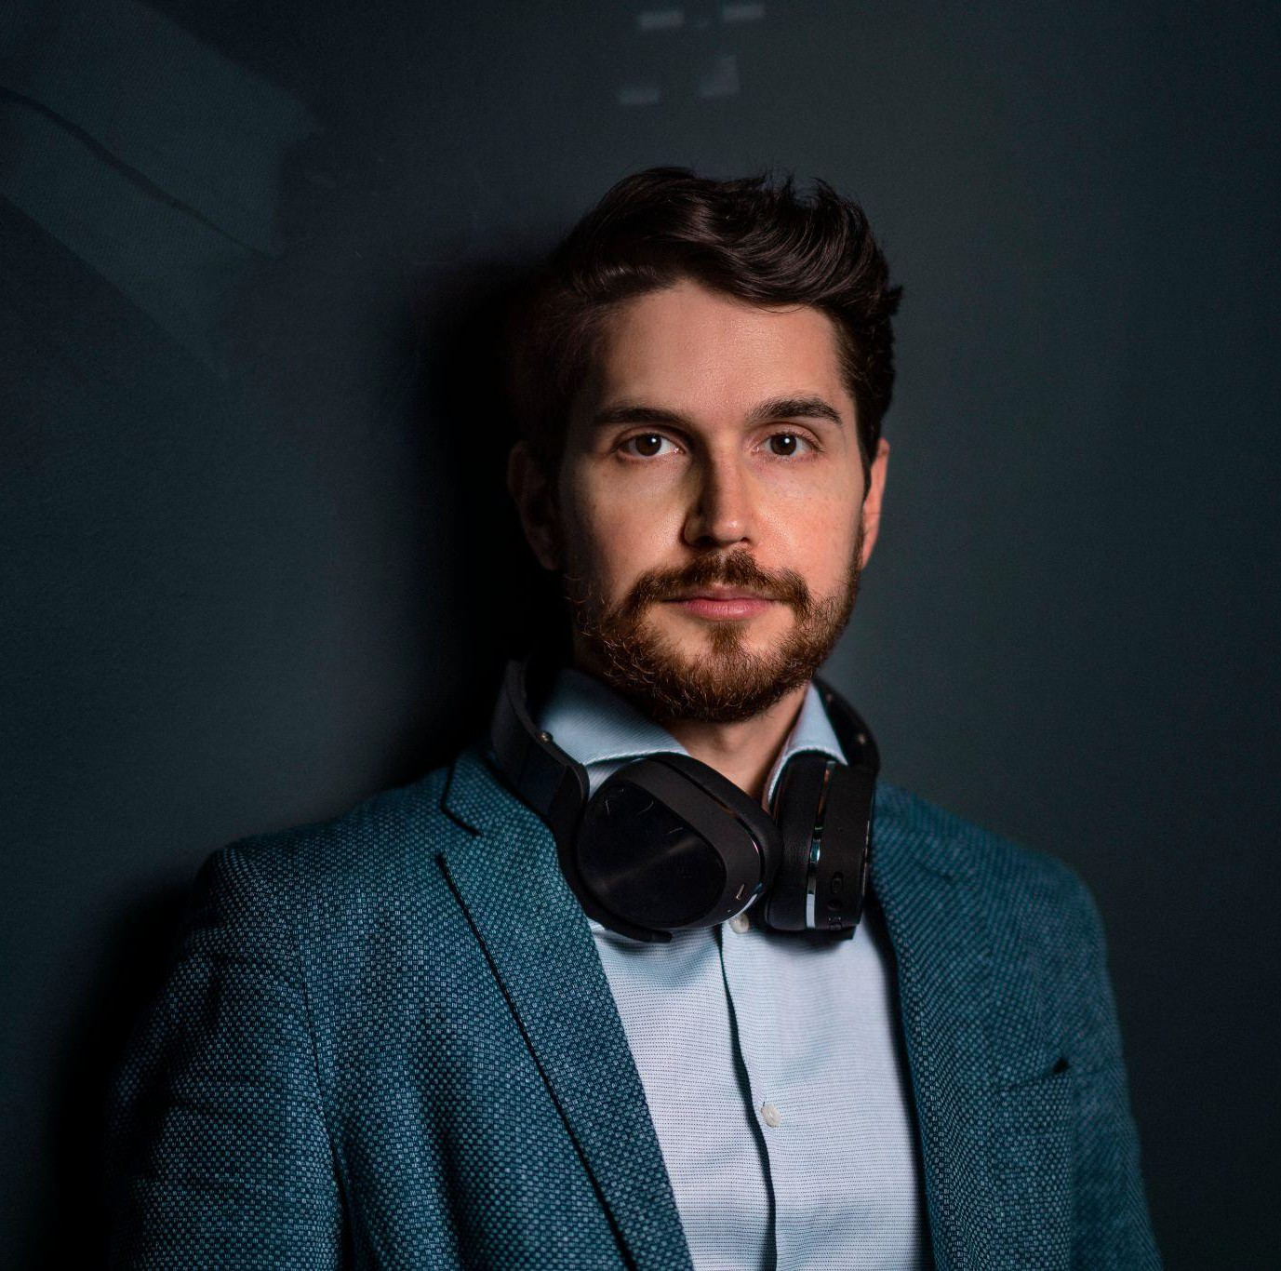
Speaker
Kambis Kohansal Vajargah
Head of Startup-Services Austrian Federal Economic Chamber

Slide 3
Startup Ecosystem

Slide 4
startup definition
no more than 10 years after foundation
seeking or exhibiting significant growth in sales, head counts or number of users
focus on international expansion and scalability
technological innovation or operating in innovative business model

Slide 5
state of the ecosystem
population: 9,067,476
over 2,600 active startups in Austria
15% growth per year (In non-Corona times)
employing an average of 9.6 employee
more than 20,000 employees overall
two thirds of all startups are Green Startups
survival rate: 80% of startups founded between 2008 and 2010 still exist
profits are generated by every fifth startup

Slide 6
state of the ecosystem
founders are on average 37 years old
70% of startup founders are university graduates
2.6 founders on average
4 out of 10 startup founders are serial entrepreneurs
21% of Austrian startups are academic spin-offs
Female founders have a share of 18% in start-ups

Slide 7
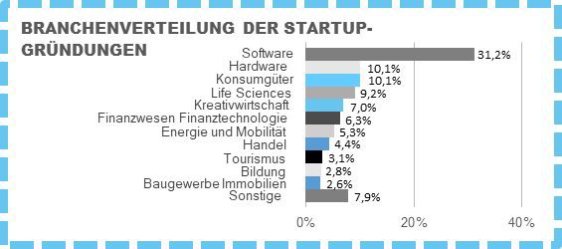
state of the ecosystem
Industries
Investments 2020
Startup | Volume | Vertical
Bitpanda | 44.6 Mio. Euro | FinTech
PlanRadar | 30 Mio. Euro | PropTech
Adverity | 27.7 Mio. Euro | AdTech
Refurbed | 15.6 Mio. Euro | Marketplace
OncoOne | 13 Mio. Euro | Life Sciences
Anyline | 10.8 Mio. Euro | OCR
goStudent | 8.3 Mio. Euro | EduTech
byrd | 5 Mio. Euro | Logistics
ready2order | 5 Mio. Euro | FinTech
Mostly AI | 4.3 Mio. Euro | AI
FireStart | 4 Mio. Euro | BPM
ToolSense | 3 Mio. Euro | IoT
Gronda | 1.5 Mio Euro | Job Marketplace
Valanx | > 1 Mio. Euro | Life Sciences
Innerspace | > 1 Mio. Euro | VR
Hi.health | > 1 Mio. Euro | InsurTech
TriLite | > 1 Mio. Euro | AR
Prewave | > 1 Mio. Euro | Big Data
SignD | > 1 Mio. Euro | Identity
Orderlion | > 1 Mio. Euro | Gastronomy
Source: ASM 2019

Slide 8
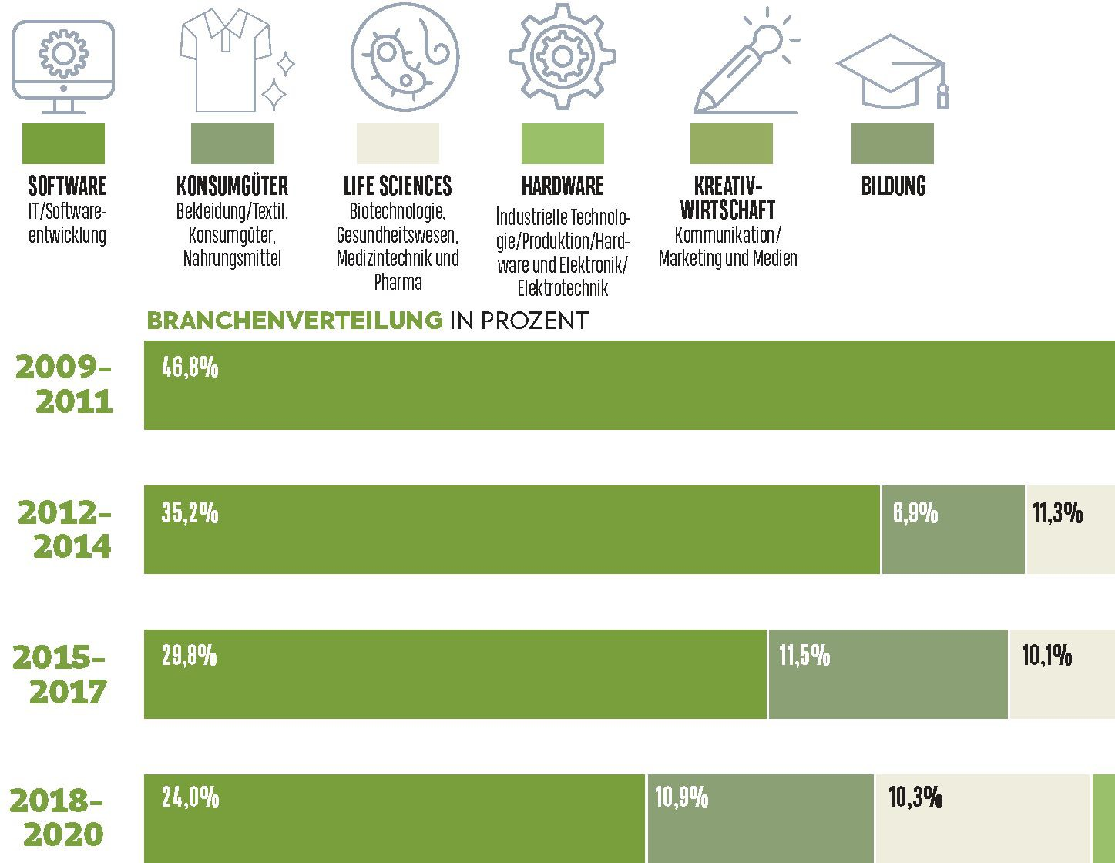
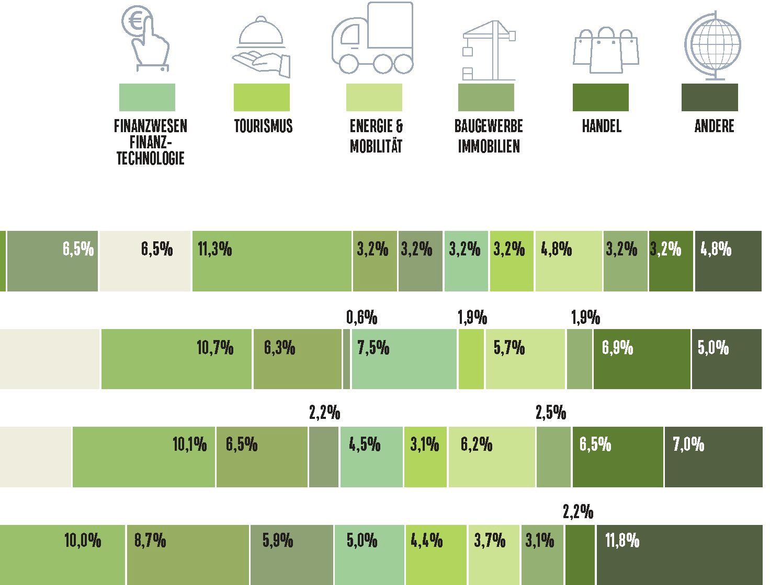
state of the ecosystem
Source: ASM 2020
Investments 2021
Volume
376 Mio. Euro
275 Mio. Euro
102 Mio. Euro
Startup
Bitpanda goStudent Adverity
Vertical
FinTech EduTech AdTech
August 2021: Investments reach more than 1 Billion Euro

Slide 9
characteristics
very robust early-stage public grants network
countless of local & global accelerators & incubators
focus on Sandboxes: Fintech Regulatory Sandbox etc.
number of female entrepreneurs is rising
strongest vertical: it & software development
greentech, particularly waste management, among strongest verticals
focus on mobile and social-first digital economy
number of female entrepreneurs is rising

Slide 10
strong verticals
BioTech
Digital HealthTech
FinTech & CryptoTech
EdTech
GreenTech
*€ 1 Mrd. in Exitvolumen an internationale Investoren

Slide 11
exits
Dutalys: 500 Million Euro
has.to.be: 250 Million Euro
ViraTherapeutics: 200+ Million Euro
Shpock: 200 Million Euro
mySugr: 150 bis 200 Million Euro
Marinomed Biotech AG: IPO
Tricentis: 136 Million Euro
Kaleido: 100 bis 200 Million Euro
PIDSO: undisclosed
Themis Bioscience: undisclosed

Slide 12
Why Startups

Slide 13
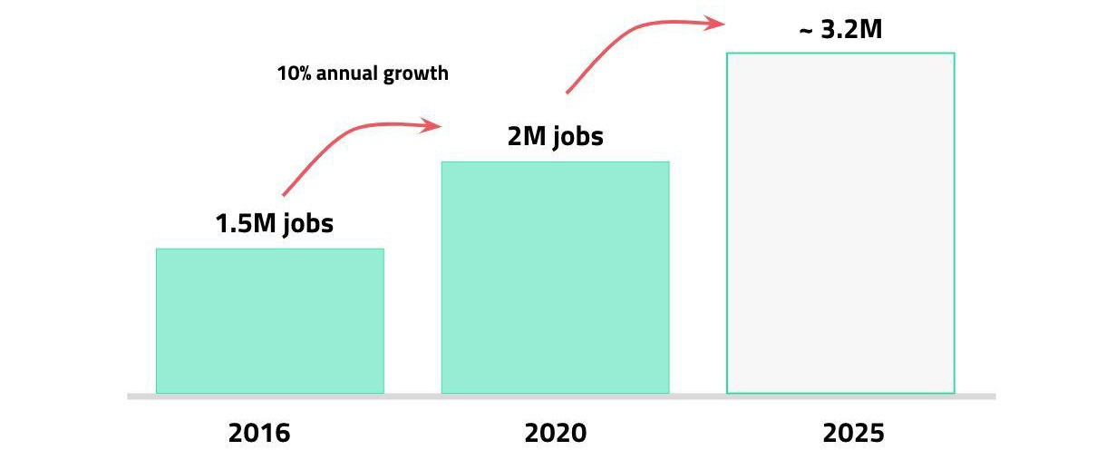
job engine of europa
Source: dealroom, sifted, European Startups

Slide 14
Current startup services
Open Office Hours
Startup Live Sparrings
Spotlight-Tour
WKO Education Initiative
înno up
Born Global Academy

